Slide 1

Laravel

Slide 2
1
What is Laravel ？
2
Features & Advantages
3
Current progress

Slide 3
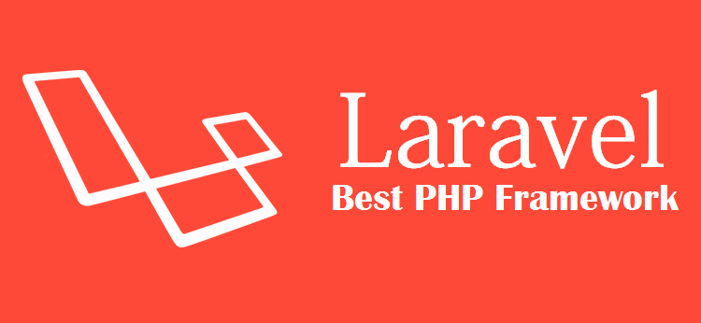
Laravel is a web application framework (PHP)
with expressive, elegant syntax.
This will provide the advantage of having a Web Application that is developer friendly and code that is maintainable.

Slide 4
Features
Laravel PHP Framework offers many features such as:
MVC Model /Controller / View
RESTful Routing Route => Supprimer, ajouter, modifier...
The Eloquent ORM
Data Migrations ...etc

Slide 5
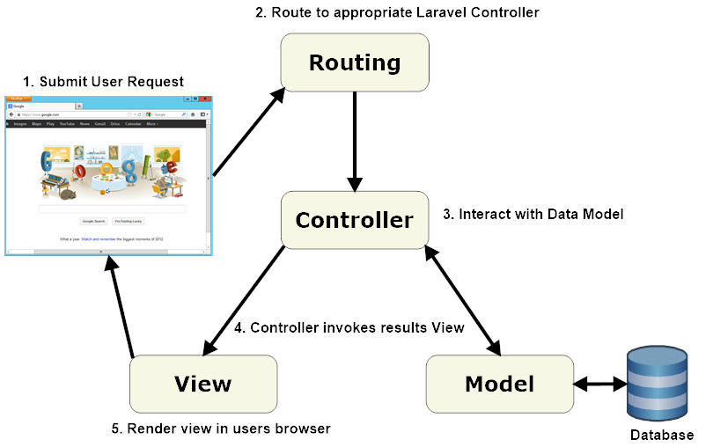

Slide 6
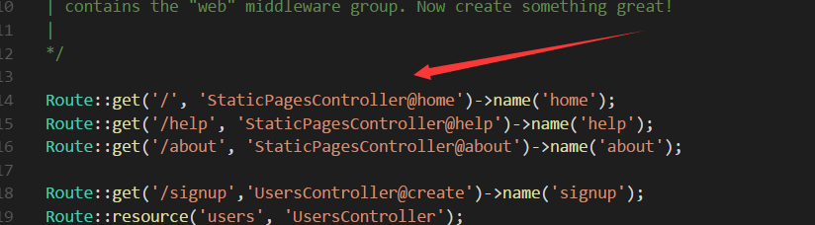
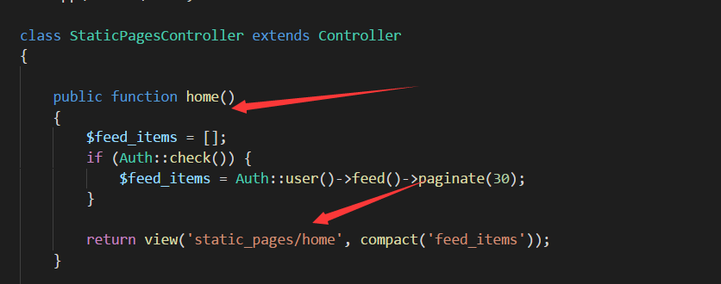
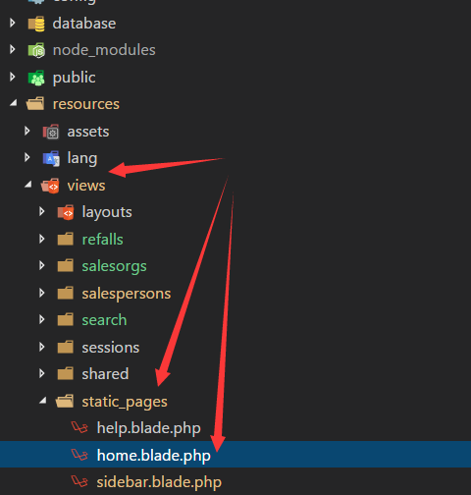

Slide 7
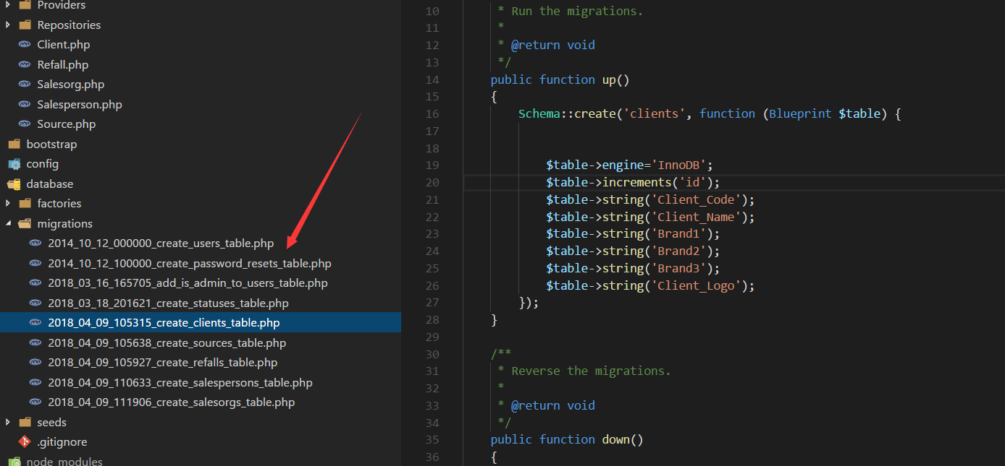

Migrate data from Laravel to Mysql or other databases by

Slide 8
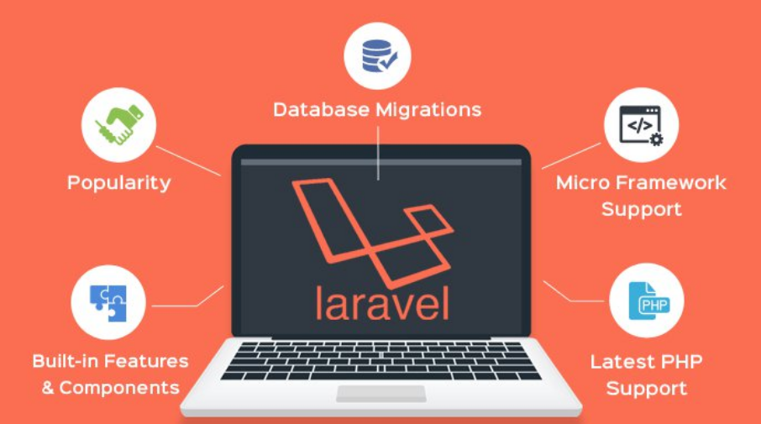
Advantages

Slide 9
Visualization and insights (ggplot2)

Slide 12
Merci pour voter attention

